Slide 1

Basic Details of the Team and Problem Statement
Ministry/Organization Name/Student Innovation: AICTE, MIC-Student Innovation
PS Code: SIH1483
Problem Statement Title: 3D map of Moon using Web Development
Team Name: The Midnights Suns
Team Leader Name: Mugunth.D
Institute Code (AISHE): U-0474
Institute Name: Sathyabama Institute of Science & Technology
Theme Name: Lunar Exploration and Education

Slide 2
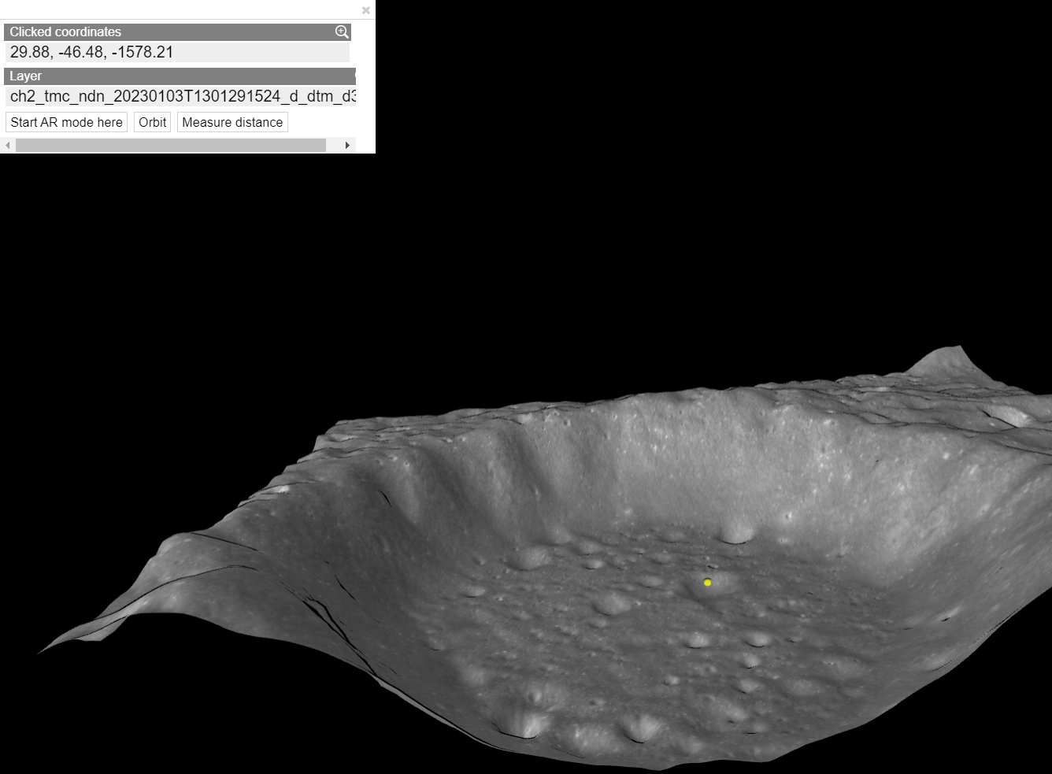
Idea/Approach Details
Describe your idea/Solution/Prototype here:
A web-based platform designed to simplify access to high-resolution lunar data from ISRO's Chandrayaan-2 mission. The primary goal is to make lunar data accessible and engaging for a wide audience, including students, educators, parents, and lunar enthusiasts.
Describe your Technology stack here:
Front-End Development: HTML, CSS, JavaScript
Back-End Development: Node.js, Python
Model Development: Blender
Web Framework: React
Cloud Hosting: GCP/AWS/Azure

Slide 3
Idea/Approach Details
Describe your Use Cases here
Describe your Dependencies / Show stopper here
Intuitive 3D visualization of lunar crates.
In depth analysis of lunar surface.
Intuitive way to educate children about the moon.
High quality map of moon for lunar exploration.
Data acquisition from ISTO.
Data processing and creating maps for texture and displacement.
Using those maps to create 3D model of moon using blender.
Converting and optimizing the Blender model to be viewed in any browser.
Delivering the model via browser with interactions and information.

Slide 4
Team Member Details
Team Leader Name: Mugunth.D
Branch : B.E Stream : CSE Data science Year : IV
Team Member 1 Name: Sukseh Raghav.G
Branch : B.E Stream : CSE Artificial Intelligence Year : IV
Team Member 2 Name: Sanjay Krishna.S.R
Branch : B.E Stream : CSE Year : IV
Team Member 3 Name: Sriram.R
Branch : B.E Stream : CSE Artificial Intelligence Year : IV
Team Member 4 Name: Yuthika.P
Branch : B.E Stream : CSE Artificial Intelligence Year : IV
Team Member 5 Name: Swetha.R
Branch : B.E Stream : CSE Artificial Intelligence Year : IV
Team Mentor 1 Name: Dr.Cruz Antony.J
Category : Academic Expertise (AI/ML/Blockchain etc): Domain Experience (in years):
Team Mentor 2 Name: Dr.Jeslin Shanthamalar
Category : Academic Expertise (AI/ML/Blockchain etc): Domain Experience (in years):

